Slide 1

Freshco Hypermarket Capstone
NAME: ARSHAD ANEES
BATCH : DAY-202309-01
CAPSTONE PROJECT - 1

Slide 2
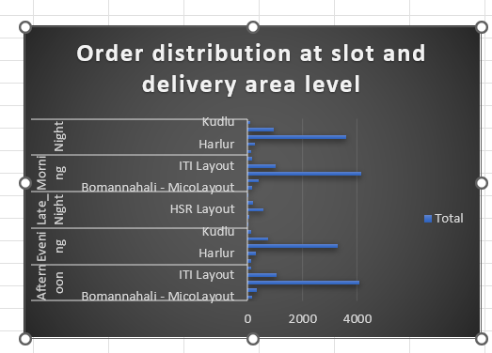
Order Level Analysis 1. Identify order distribution at slot and delivery area level. ANALYSIS:As we can see in the bar chart , HSR layout has the highest order count in all the delivery slots

Slide 3
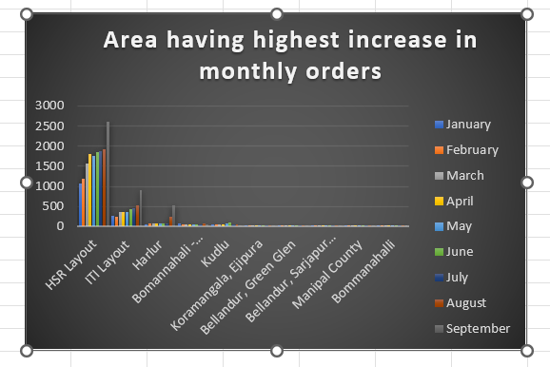
2. Identify the areas having highest increase in monthly orders (from Jan to Sep) in absolute orders.
ANALYSIS: September month is having the highest number of orders from hsr layout

Slide 4
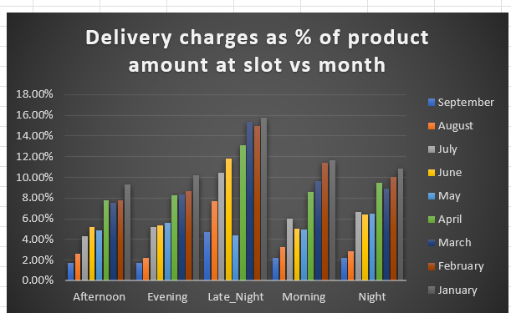
3. Calculate delivery charges as a percentage of product amount at slot and month level. ANALYSIS: We can clearly see that delivery charges as % of product Amount is highest at late nights

Slide 5
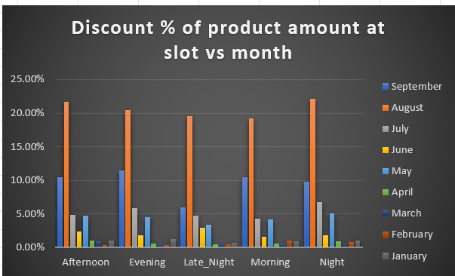
4. Calculate discount as a percentage of product amount at slot and month level. ANALYSIS: We can see that discount percentage of product amount is increasingly high in August month , so users can order in august month to get more discount

Slide 6
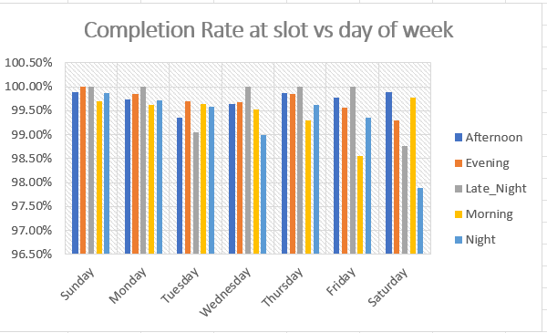
Completion Rate Analysis
6. Identify Completion rate at slot vs day of the week (Sunday to Saturday) level. Can you spot some pattern in the data?
Analysis :Sunday has more completion rate out of all days in a week , also during the afternoon.

Slide 7
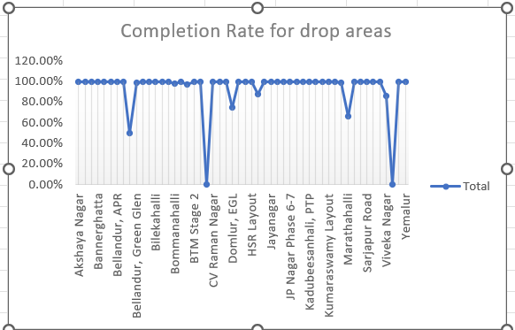
7. Calculate completion rate at drop area level. Analysis: the orders completed drastically drops in cv raman nagar and viveka nagar

Slide 8
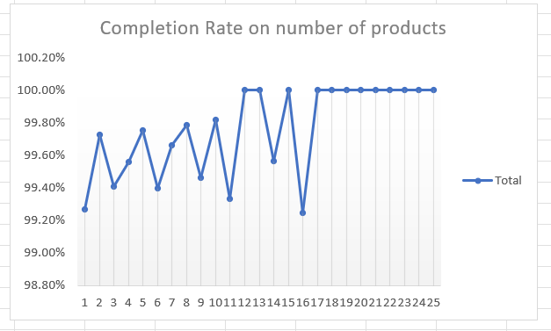
8. Completion rate at number of products ordered level. For this first you need to create a column having number of product against every order. Analysis : As number of products are increased , the completion rate also increases

Slide 9
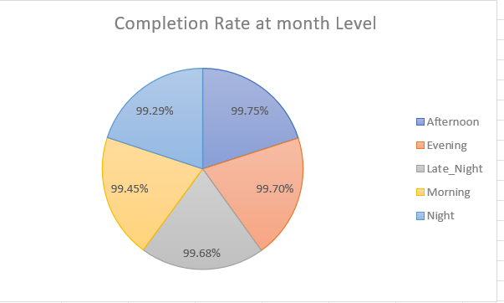
9. Give you analysis on the any pattern you observe in the completion rate. Analysis: The completion rate is highest in the afternoon .

Slide 10
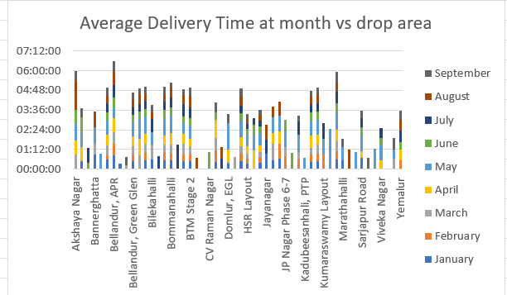
Delivery Analysis
17. Calculate average overall delivery time at month and delivery area level.
Analysis: We can see that may month has highest delivery time

Slide 11
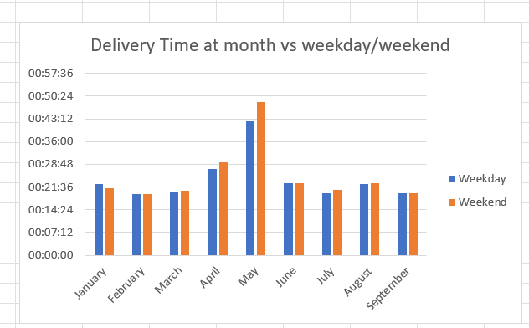
18. Calculate average overall delivery time at month and weekday/weekend level. You might need to create a column which will tag every date to either weekday or weekend.
Analysis: May month has highest average delivery time , since this month has more orders because of the discounts given

Slide 12
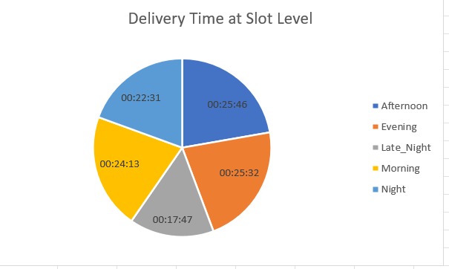
19. Calculate average overall delivery time at slot level. Refer to the definition of slot.
Analysis: Delivery time in afternoon is more , since more orders are ordered at that time

Slide 13
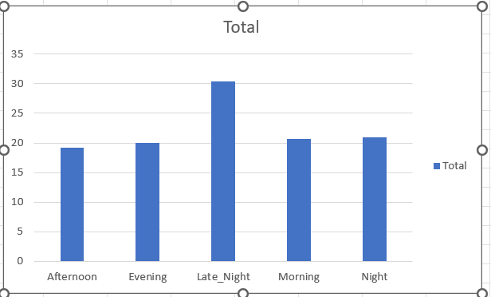
20. Do you see any pattern in delivery charges with slot or delivery area.
Analysis: we can see that late night delivery charges are the highest because of less delivery guys available

